Slide 1
Wind River VxWorks
Real Time System
Name: Mohamad Luqman Idlan bin Mohamad Azahari
Matric: 1723539

Slide 2
Wind River History
Founded in 1981
Headquaters in Alameda, CA
It is the global leader in device software optimization (DSO)
More than 300 million devices worldwide used
Examples: Apple, Hewlett Packard, Boeing, Motorola, NASA and Mitsubishi

Slide 3
DSO
DSO allows companies to develop and run device software faster, easier and more reliable at lower cost
Seamless integration of technology across an entire enterprise
Reuse of the best technology
Risk reduction by using proven technology

Slide 4
VxWorks History
Created in early 1980’s
6 version released in over 20 years
The most used RTOS nowadays
Easy and efficient to use
meet the needs of customers over a broad range of industries

Slide 5
VxWorks Features
Support priority-based preemptive scheduling (wind) and roud-robin scheduling
Tasks share memory
Up top 256 priority levels

Slide 6
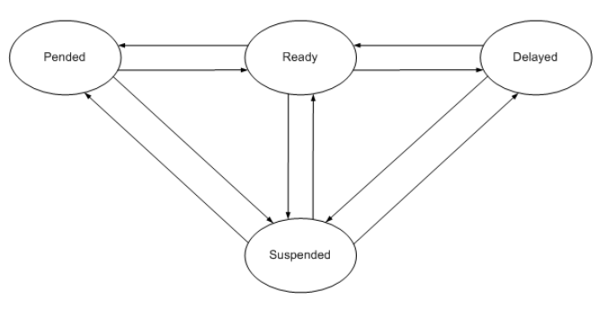
Task Model

Slide 7
Intertask Communication
VxWorks supports:
shared memory
semaphores (binary and counting)
Mutexes (POSIX interfaces)
Message queues and Pipes
Sockets and RPCs
Signals
Mutex semaphore supports priority-inheritance algorithm

Slide 8
Kernel Clock
The kernel has its own clock
The clock defines the resolution of scheduler operations
Default frequency of 60Hz
Maximum and minimum values are hardware dependent

Slide 9
VxWorks version 6
Real-time process (RTP) model introduced
Kernel remains backwards compatible
Tornado IDE replaced with Wind River Workbench (Eclipse-based)
Increased POSIX compliance
Improved OS scalability
Support additional architectures

Slide 10
Supported Hosts
Red Hat Enterprise Workstation
Solaris
SuSE Linux Desktop
Windows 2000 Professional
Windows XP

Slide 11
Supported Target Architectures
ARM
Intel
Intel XScale
MIPS
PowerPC
SuperH

Slide 12
Real-Time Process Model
Processes run in their own memory space
The kernel and other processes are protected
Takes advantage of CPUs with a memory management unit (MMU)
An error in a process cannot crash the entire system

Slide 13
User Mode vs Kernel Mode
A protected user mode is an area where applications execute
An unprotected kernel mode is an area where the OS kernel and drivers execute
Traditionally VxWorks supported a lightweight kernel-based threading model
The RTP model supports both user and kernel modes

Slide 14
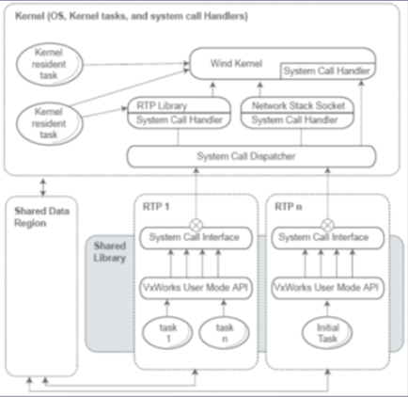
RTP Architecture

Slide 15
RTP Architecture Overview
RTPS are isolated both from the kernel and from each other
Applications execute independently
Memory protection is provided by the MMU
Application libraries and data memory can be shared between RTPs

Slide 16
Kernel and RTP interaction
A system call trap interface is used to access kernel services
Tasks in different RTPs may interact using shared data regions and inter-process communication (IPC) mechanisms

Slide 17
Task Execution
The RTP itself is not a schedulable entity
An RTP can contain many tasks
Multiple instances of an RTP can execute independently and concurrently
RTPs must be fully loaded when they are created (Latency may be a problem)
Only the tasks are scheduled
A global task scheduler schedules tasks across all RTPs

Slide 18
Memory Model
Virtual memory manager introduced for VxWorks 6
Kernel heap is reduced to create an area of unmapped physical pages
Kernel heap size is configurable
An RTP task running in user mode only has access to the RTPs memory space
The task can trap into kernel mode via a system call

Slide 19
Conclusions
VxWorks is a powerful and highly scalable RTOS
The new RTP model makes VxWorks usable for a wide range of real-time system applications
The RTP model preserves scalability performance and determinism
RTP support itself is a scalable component

